Slide 1




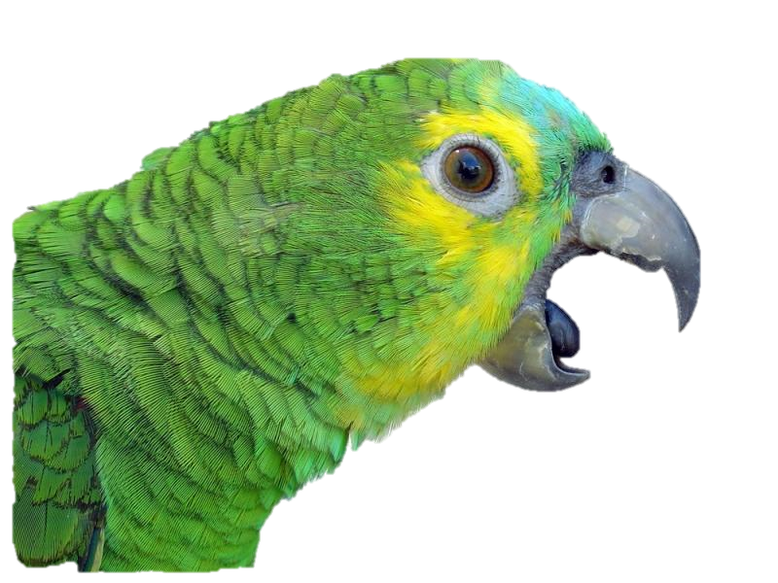
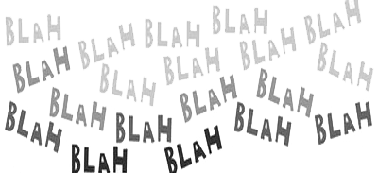
an enterprise chat system for XtremeSecurity

Slide 2

Description
Our project has been developed in reply to XtremeSecurity. The Enterprise needs to develop a chat system from scratch. We cover their need to exchange messages & files in a secure way among employees.
The requested functionalities of the system were:
exchange messages & files of arbitary size
encrypted communication with server
configure user account
create & manage local address book
block/unblock users
access to company’s material repository
show personal statistics about program usage
(admin feature) manage all users and view global statistics of program usage

Slide 3
architecture
Server
GUI
Encrypted
connection

Slide 4
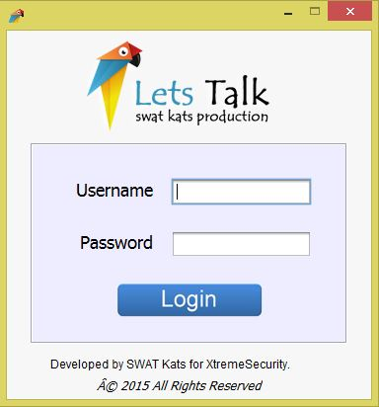
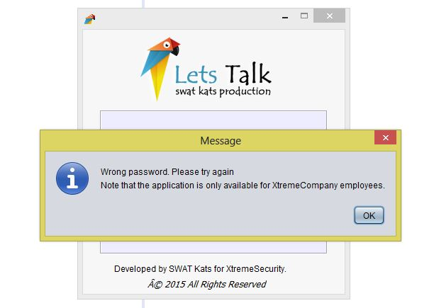
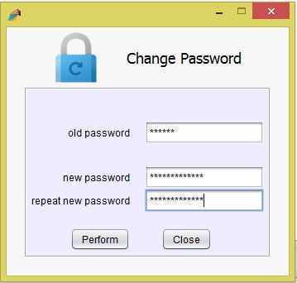
Design
1. A user tries to login for the service must authenticate himself against a user database maintained in a central server.
2. Configure the user account.

Slide 5
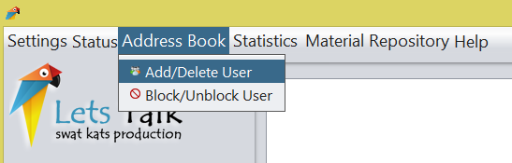
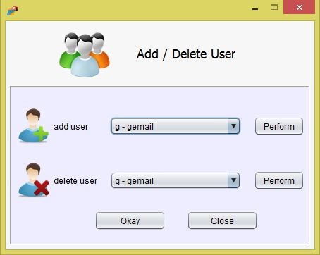
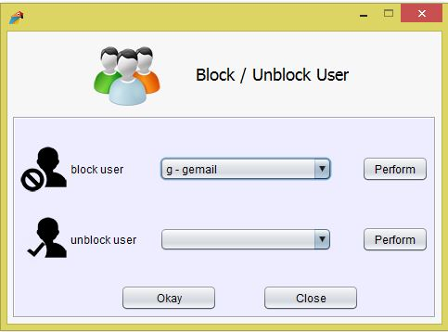
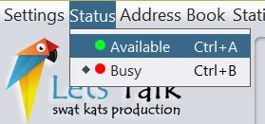
Design
3. Address book: add/remove/browse users in a local address book. Users in the address book have an associated status (offline, available, idle, busy).

Slide 6
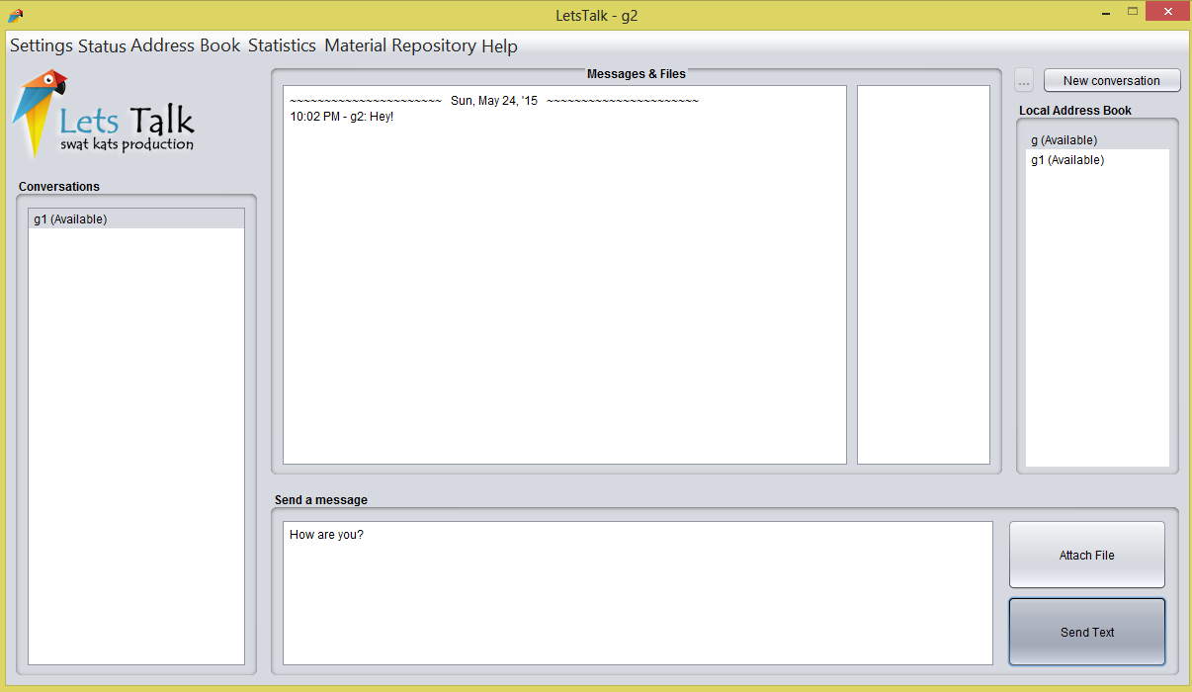
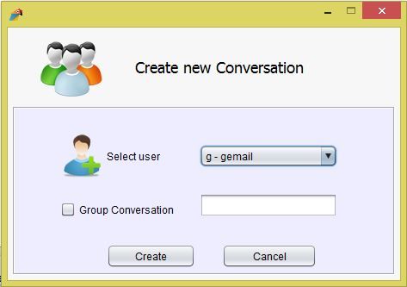
Design
3. Create new conversation and sends text

Slide 7
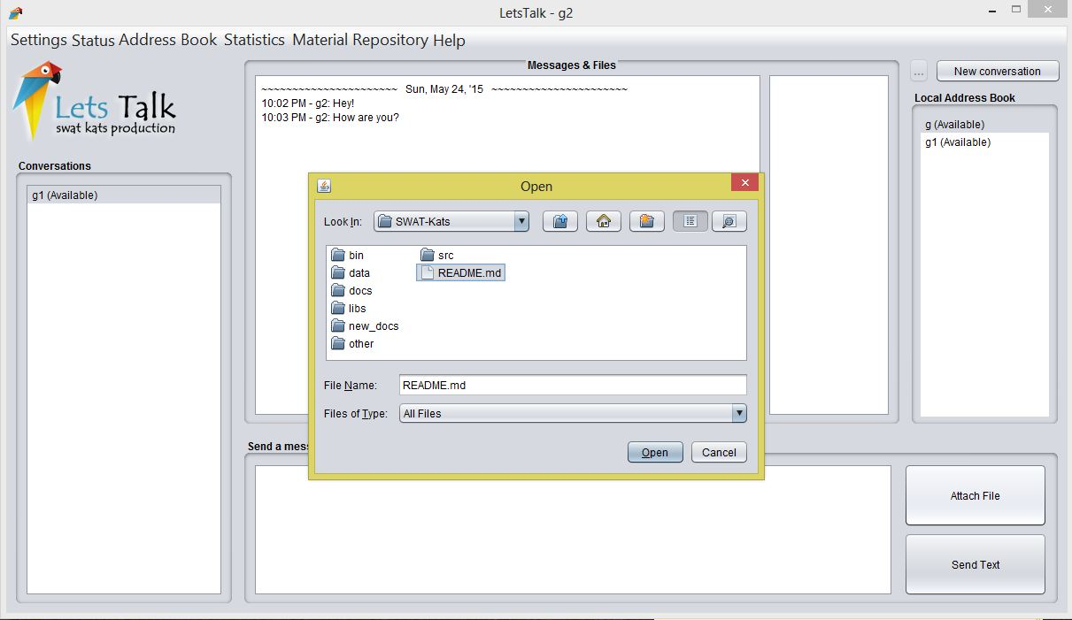
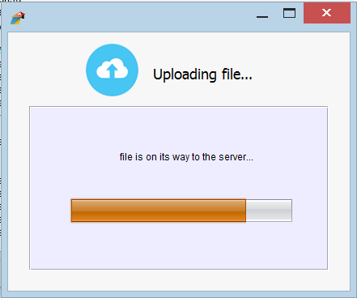
Design
4. Upload file and download file

Slide 8
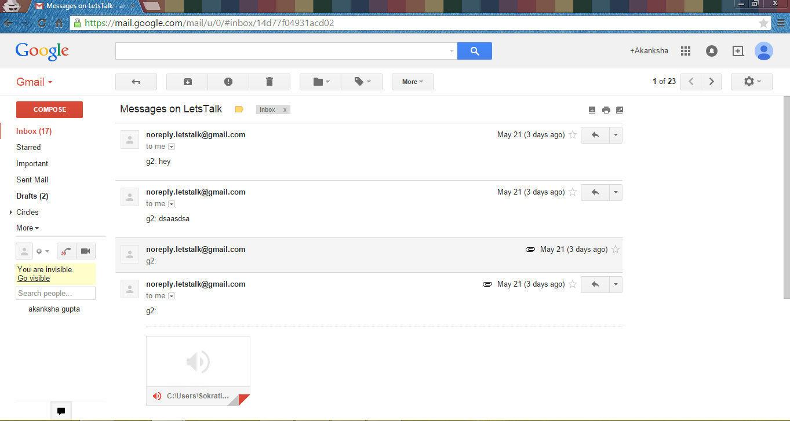
Design
5. Email to offline user (text & files)

Slide 9
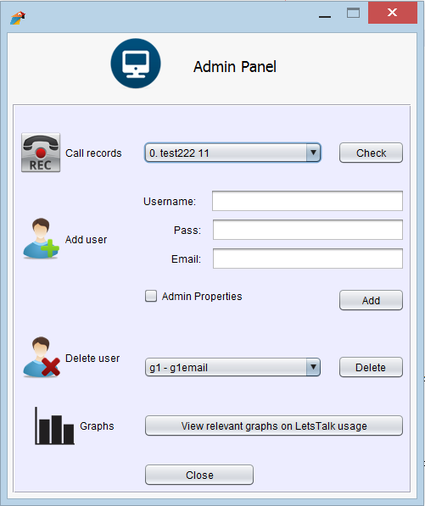
6. ADMIN PANEL
View call records of conversations
Add user to application
Delete user from application
View graphs on application activity

Slide 10
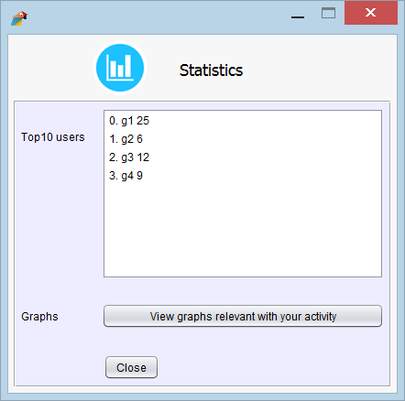
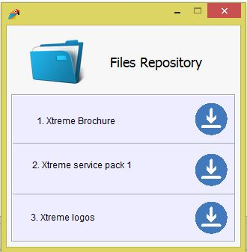
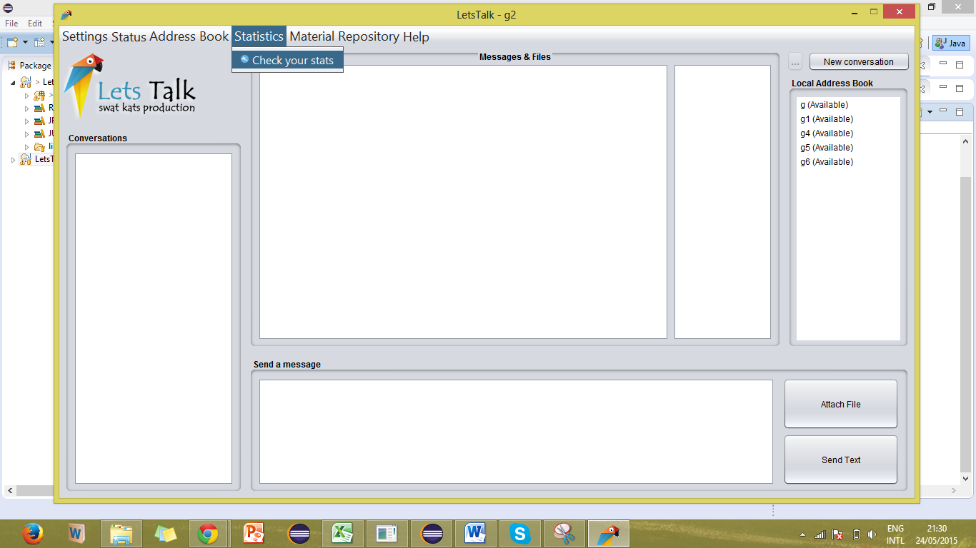
Design
7. Statistics
8. Material Repository

Slide 11
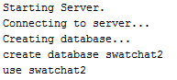
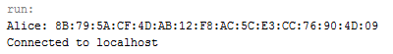
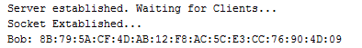
Architecture / Design
And… Behind every successful client there is a server. “The Server” :
Connection
Server
Client

Slide 12

Technical Challenges
Did not have a server use for the application, so we created it locally.
Database Connection closed after a certain time (c3p0 connection pulling).
In file download, if a user double clicks to download a file, it causes two sockets on same port from one ip which causes trouble.
Establishing the right architecture/communication between GUI and Database
Working on Netbeans & Eclipse.

Slide 13



Challenges | Failures | Success Stories
The main challenge was the limited amount of time we had.
Inefficient communication. Missing inner deadlines.
Failed to take full advantage of capabilities of each individual, but relatively good project segmentation and allocation.

Slide 14


Challenges | Failures | Success Stories
Failed to plan correctly in the beginning, taking into account all requirements.
Meeting in smaller groups, having a more effective time.
Each member respected the code of others; provided solutions if possible.
Challenged by the personal calendars of group members (out-of-country)
We had good organization that leaded to effective & productive work, especially under pressure.
Parallel work on project documents & development.

Slide 15

WORKED / FAILED
Block/unblock in group chat
You get to feel like Mark Zuckerberg if you are an admin. Graphs, Stats, God’s eye :)
Better than Facebook now! You also have File repository
Automatic refresh
-----------------------------------------------------------------------
Some test requirements didn’t happen as planned
Some features requested are not yet implemented (seen/edit messages)
Multitasking in lots of different processes → caused confusion

Slide 16

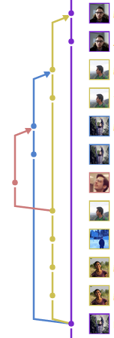

Git - Curse and a Blessing
Blessing
Distributing and updating code for all team members made easy.
Monitoring the changes made to the files in the commits to resolve errors.
Lots of features such as tags, branches and milestones that make project work easier.
Monitoring of team activities made easier (especially for supervisor)
Curse
Merge Conflicts cause a kind of Merge-Fear. (Merging can lead to a lot of work, including undoing local changes and communication with teammates.)
Parallel work is avoided as far as possible. thats not the intention of the tool!

Slide 17


COnclUSION
Learning points
Realizing the challenges of big group work and importance of coordination.
Understood the importance of management tools & project manager.
Experienced a “real-life” documentation required to develop a complex system.
Experienced a “real-life” software development in a group with git.
What we keep
We implemented a fully functional enterprise chat system in a month.
We gained great experience in multiple things (documentation, git, development, teams).
We are proud of our work and we had fun (and some frustration) developing it.

Slide 18


